Slide 1
REQUIREMENT ENGINEERING

Slide 2
Lesson 5: Requirement Analysis

Slide 3
Previously…
Introduction to Requirement Elicitation
Importance of Requirement Elicitation
Stakeholders and Sources of Requirements
Techniques for Requirement Elicitation
Challenges in Requirement Elicitation
Best Practices for Effective Requirement Elicitation

Slide 4
Chapter Outlines
Introduction to Requirement Analysis
Structuring Requirements (Use Cases and User Stories)
Requirement Prioritization
Conflict Resolution in Requirements
Requirement Modeling
Quality Attributes of Good Requirements
PIECES Framework for Requirement Analysis
Tools for Requirement Analysis

Slide 5
Where We Are Now
Requirement Elicitation ✅
"Users need to upload a profile pic. It should look super crisp on modern phones and high-res monitors. Make sure the file size is tiny so our app doesn't slow down. Also, users want to edit or crop them right in the app. Let's make it look like Instagram's setup. Oh, and legal says we need to make sure users aren't uploading anything inappropriate, so auto-moderate that, but do it instantly so they aren't waiting." [1]

Slide 6
What’s Wrong with Raw Requirements?
Conflicting Goals
Higher resolution vs Small file sizes
Scope creep
In-app photo editor could be a massive undertaking
Missing Constraints
What file types are allowed (jpeg, pdf, docx) and what file sizes are allowed?
Vague terms
What “inappropriate” mean exactly (secular vs sharia context)

Slide 7
What is Requirements Analysis?

Slide 8
What is Requirements Analysis
Requirement Analysis is a crucial phase in the Requirements Engineering process where the raw data collected from stakeholders is refined into precise, actionable requirements.
This step ensures that the requirements are well-understood, unambiguous, and aligned with the stakeholders’ expectations, laying a solid foundation for the design and development phases.

Slide 9
Why Requirements Analysis
Key Objectives:
Convert elicited data into structured requirements.
Prioritize requirements based on value, cost, and feasibility.
Resolve conflicts and ensure alignment among stakeholders.
Model requirements to provide clear communication and understanding.

Slide 10
Structuring Requirements (Use Cases vs User Stories)

Slide 11
Use Cases
A use case describes a sequence of interactions between a system and an external actor that results in the actor being able to achieve some outcome of value.
How to Construct a Use Case:
Written in the form of: Verb + Object
Descriptive Names
Sample Use Cases

Slide 12
Use Cases
Actors in a Use Case: A use case describes a sequence of interactions between a system and an actor
Therefore, an actor is a person or a system or hardware that interacts with a system to perform a use case
How to Identify actors:
Who (or what) is notified when something occurs within the system?
Who (or what) provides information or services to the system?
Who (or what) helps the system respond to and complete a task?

Slide 13
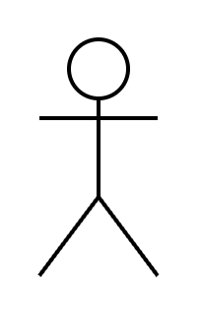
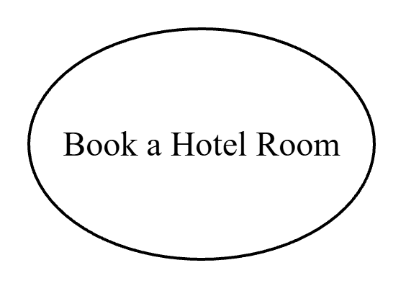
Use Cases
Use Case Diagrams:
A high-level representation of a use cases usually done using the Unified Modelling Language (UML).
Elements of a Use Case Diagram:
Actors
Use Case
Notes:
UML came up in the mid to late 1990s created by a team known as the three amigos. The problem they were trying to solve was for software developers to be able to specify, visualize and document the systems that they were building. It provided a standardized, language agnostic and extensible way to model software architecture and design.

Slide 14
Use Cases
Elements of a Use Case Diagram (Cont…):
System Boundary: Defines the scope of the system being modelled. What is in the system.

Slide 15
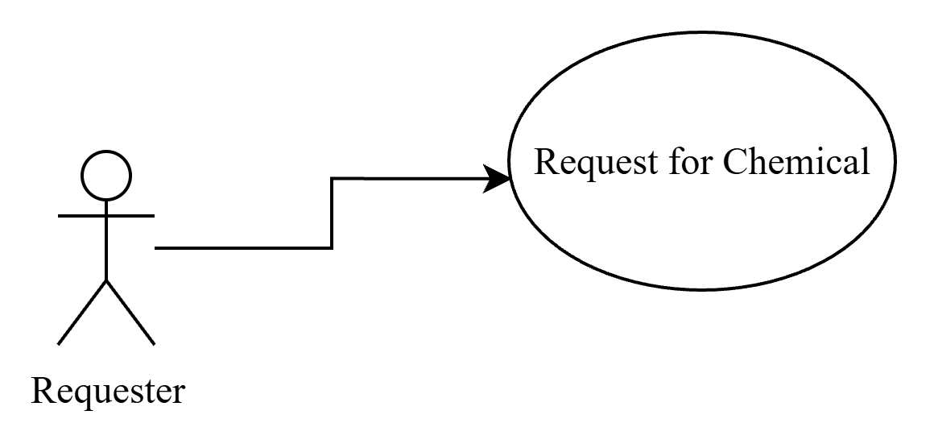
Use Cases
Elements of a Use Case Diagram (Cont…):
Arrows: Serve a number of purposes depending on its direction or style.
Actor to Use Case: Indicates that the actor is the primary actor for that use case.

Slide 16
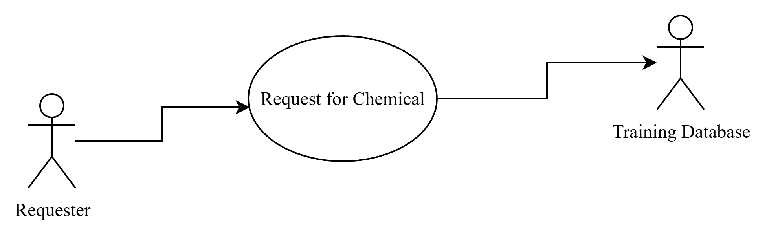
Use Cases
Elements of a Use Case Diagram (Cont…):
Arrows: Serve a number of purposes depending on its direction or style.
Use Case to Actor: Indicates a secondary actor who (human or other system) participates somehow in the successful execution of the use case.

Slide 17
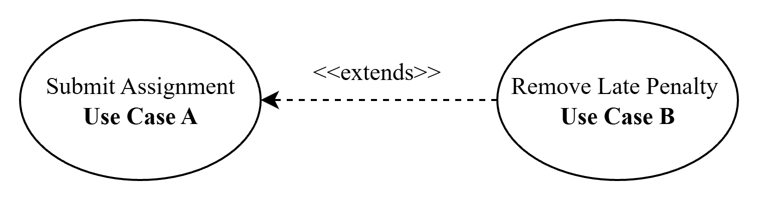
Use Cases
Elements of a Use Case Diagram (Cont…):
Arrows: Serve a number of purposes depending on its direction or style.
Extend: Models a conditional relationship between two use cases whereby use case B extends the normal flow of use case A (note the direction of the arrow)
Notes:
In this scenario, requesting a chemical should request it from the stockroom, however there is an option for the person requesting a chemical to search through the catalog of vendors. Another example would be a system with a use case of submitting an assignment. This use case would have a relationship with a use case of applying a late penalty is the student submits the assignment late.

Slide 18
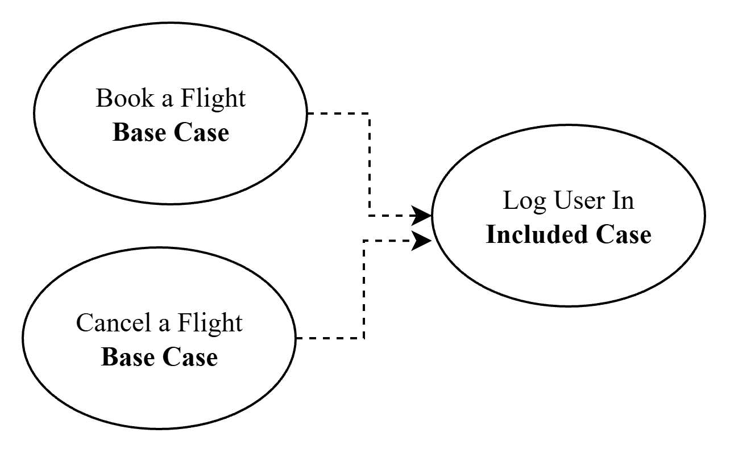
Use Cases
Elements of a Use Case Diagram (Cont…):
Arrows: Serve a number of purposes depending on its direction or style.
Include: Models a relationship where a base use case explicitly incorporates the behavior of another use case at a specified point.
Notes:
"Models a relationship where a base use case explicitly incorporates the behavior of another use case at a specified point. The inclusion is mandatory; the base use case cannot complete its main flow without executing the included use case.

Slide 19
User Stories
What is a User Story?
A user story is a description of functionality that will be valuable to a user or buyer of a system or software.
It is an informal description of a software feature written from an end-user’s perspective. The goal of a user story is to articulate how a software feature will deliver value back to the customers.
It can also be seen as the smallest unit of work in an Agile framework.
Notes:
Informal because the customer is the priority and thus they should be able to understand these stories.

Slide 20
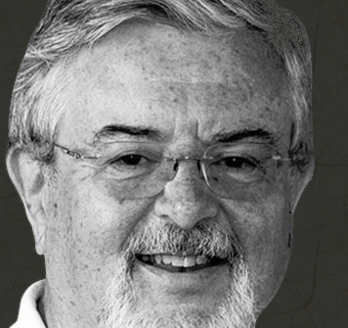
User Stories
The Three C’s of User Stories
Card: Usually, a physical note that captures the user’s intent with the system.
Conversation: Refers to the discussions between developers, stakeholders and product owners to flesh out the details of cards.
Confirmation: The acceptance criteria that prove that a story is done and working as expected.
Ron Jeffries

Slide 21
User Stories
As a <particular user>, I want to <accomplish this task> so that I can <achieve this objective or goal>. Estimate: Priority:
As a student, I want to download my transcript so that I can have a digital copy of my transcript. Estimate: Priority:
Notes:
Cards used to be physical and written manually on Post-it cards (Sticky Notes) but today they can also be digital. What matters about the card is less the material the card is made of and more the content of the card. Cards are used because they are small and thus you are also forced to keep your user stories as short as reasonably possible. The card represents the team’s commitment to discuss the story hence the Conversation part of the 3C’s.

Slide 22
User Stories
The Three C’s at Work
1. Create the card: Write out user stories on physical cards or digitally. Keep them simple, no technical details, capture everything from the user’s perspective.
2. Engage in Conversations: Discuss each card with stakeholders and clarify any uncertainties you might have about the user stories on the cards.
3. Define Confirmation Criteria: Have guidelines that clearly define what it means for each user story to be “done”. This is your checklist for the validity of the work done on a user story.

Slide 23
Writing User Stories: INVEST
I.N.V.E.S.T
Independent: A user story should be able to stand on its own and not have dependencies with other stories. One should be able to develop and test each user story independently.
As a student, I want to pay my tuition fees online so that I can meet my financial obligations.
As a student, I want to register for courses, pay my tuition fees, and receive my class timetable so that I can begin the semester.
As a student, I want to view my semester timetable after successful registration so that I know when my classes take place.
As a student, I want to register for available courses so that I can enroll in my semester.

Slide 24
Writing User Stories: INVEST
I.N.V.E.S.T
Negotiable: Stories are not contracts, but rather reminders that a conversation needs to be had. Include the right amount of detail.
As a professor, I want a drop-down menu containing exactly 12 preset grading rubrics using Arial 12pt font to grade assignments.
As a professor, I want to apply standard grading rubrics to student assignments so that I can grade consistently and save time.

Slide 25
Writing User Stories: INVEST
I.N.V.E.S.T
Valuable: Stories should show the value they deliver to the purchaser or user and not the developer. Endeavor to show how the story benefits the user.
As a developer, I want to optimize the database indexing for the course_sections table.
As a student, I want search results for available courses to load in under two seconds so that I can register quickly during peak hours.
Notes:
The purchaser might have different things that bring them value as opposed to the user. The purchaser might be paying the software for 5000 people and one of their stories might be how the software will be documented. This might not be very useful to the individual users of the software though.
The goal of indexing is to increase the speed of database queries and thus can be rephrased to say the above.

Slide 26
Writing User Stories: INVEST
I.N.V.E.S.T
Estimatable: The developers need to be able to estimate or make a good guess at how long it will take for the story to turn into working code.
Reasons for Lack of Estimation | Solutions
Lack of Domain Knowledge | Discuss with the customer for clarification.
Lack of Technical Knowledge | Choose a developer to experiment with the technology.
The Story is Too Big | Create an epic out of the story.
Notes:
1. Imagine working on a medical system that requires “New users to get a diabetic screening”. For someone who has never worked with diabetics, it might be challenging to understand what diabetic screening means. Does this involve a simple form or are we meant to send a screening kit to the person’s home? 2. Imagine you are asked to build a system with a chatbot, would you know how long that would take without ever building one? So now you have to go online and find different resources on how chatbots are built.
An epic is a large body of work that cannot be completed in one agile iteration. Epics are made up of smaller stories.

Slide 27
Writing User Stories: INVEST
I.N.V.E.S.T
Small: Too large or too small stories become hard to plan for. The right story size depends on the team’s capabilities and the technologies in use.
Too Large? Split the Story
Too Small? Combine the Stories
Notes:
If you are training a model, there are certain constraints that will be placed on the team and how fast it can go since models take time to build.

Slide 28
Writing User Stories: INVEST
I.N.V.E.S.T
Testable: Stories need to tell developers when they should consider their work done. Always aim for tests that can be automated.
As a professor, I want the attendance tracking feature to be user-friendly and fast.
As a professor, I want to log student attendance with a single click per student so that I can complete the roster in under two minutes.

Slide 29
User Stories: Acceptance Criteria
Acceptance Criteria refers to a set of conditions or rules that a user story must meet in order for it to be considered done. It tells developers what to build and testers how to verify it.
GIVEN – WHEN – THEN: Refers to a format of crafting acceptance criteria and it gives a structured and understandable way of expressing the desired behavior of a user story.

Slide 30
User Stories: Acceptance Criteria
GIVEN – WHEN – THEN
Sets the stage for the scenario that is going to be described in the acceptance criterion that is about to be stated. It gives context about the system.
Scenario: As a student, I want to see a visual checklist of my remaining general education requirements so that I know what to take next semester.
Given the student is logged into the degree portal and views the checklist

Slide 31
User Stories: Acceptance Criteria
GIVEN – WHEN – THEN
Represents an action that the user performs or an event that happens within the system that triggers the behavior described in the user story.
Scenario: As a student, I want to see a visual checklist of my remaining general education requirements so that I know what to take next semester.
When they have not completed the "Historical Studies" requirement

Slide 32
User Stories: Acceptance Criteria
GIVEN – WHEN – THEN
Describes the consequence of the action performed in the WHEN clause before usually in terms of observable changes in the system.
Scenario: As a student, I want to see a visual checklist of my remaining general education requirements so that I know what to take next semester.
Then the system displays a red "Incomplete" icon next to it
And a link is provided to view upcoming eligible history courses.

Slide 33
User Stories: Acceptance Criteria
Scenario: As a customer, I want to be able to add items to my shopping cart so that I can purchase them later.
Given I am on the product page
When I click the “Add to Cart” button for a product
Then The product should be added to my shopping cart
And The cart icon in the navigation bar should display the updated item count
And I should see a confirmation message indicating the addition of the product to the cart

Slide 34
Yesterday…
What’s Wrong with Raw Requirements
Defined Requirements Analysis
Rationale for Performing Requirements Analysis
Structuring Requirements (Use Cases and User Stories)
Use Cases and Use Case Diagrams
User Stories – 3C’s, INVEST, Acceptance Criteria

Slide 35
Today…
Requirements Prioritization
Conflict Resolution
Requirements Modeling
Quality Attributes of a Good Requirement
PIECES framework
Tools for Requirements Analysis

Slide 36
Requirement Prioritization
Definition: Requirement prioritization involves ranking the requirements to determine which ones are essential to the project’s success and which are desirable but not mandatory. It helps in resource allocation and in making informed decisions about what to include in the current project scope.

Slide 37
Requirement Prioritization
Why Prioritize Requirement?
Optimal Resource Management: Projects exist within constraints of time, money and labor therefore one ought to allocate resources in a way that yields the most return.
Defensible Scope Reduction: It becomes easy to know what requirements to drop in case of budget cuts or tighter deadlines.
Managing Expectations: Stakeholders and developers can agree that everything is not urgent.
Risk Mitigation: The team can address riskier requirements by giving them a higher priority.

Slide 38
Requirement Prioritization Techniques
MoSCoW Method:
Must Have | Should Have
Could Have | Will Not Have

Slide 39
Requirement Prioritization Techniques
Must Have: Critical requirements that are non-negotiable for the system's basic functionality. Without these, the project will fail.
Should Have: Important requirements that are not critical but add significant value. They should be included if possible.
Could Have: Desirable but not necessary requirements that can be included if time and resources allow.

Slide 40
Requirement Prioritization Techniques
Will Not Have: Requirements that are agreed to be deferred or dropped in this phase.
The MoSCoW method helps you group different features under specific buckets, but it does not tell you what features belong to what buckets. For this you will need to look into other strategies that help you figure out which features are of the highest value (reading link below)
Prioritization Strategies

Slide 41
Requirement Prioritization Techniques
Kano Model
A framework for understanding how different features of a product impact customer satisfaction.
It is an approach of prioritizing features on a product roadmap based on the degree to which they are likely to satisfy customers

Slide 42
2. Requirement Prioritization
Kano Model
Delighted
Excitement
Performance
Not Implemented
Basic
Fully Implemented
Dissatisfied

Slide 43
2. Requirement Prioritization
Categories of Features in Kano Model
Basic Needs: Expected and assumed features. If missing, users are dissatisfied. Usually taken for granted by users.
Performance Needs: Directly linked to satisfaction. The more you provide, the happier the user.
Excitement Needs: Unexpected features that delight users and exceed expectations. These are innovative features that your competition does not have.

Slide 44
Conflict Resolution in Requirements
Definition: Conflict resolution is the process of identifying and addressing disagreements between stakeholders regarding system requirements. These conflicts can arise due to differing priorities, perspectives, or expectations.
Conflict Resolution Techniques:
Negotiation: Engaging stakeholders in discussions to reach a mutually acceptable compromise. It involves active listening, understanding the underlying interests, and finding a middle ground.

Slide 45
3. Conflict Resolution in Requirements
Facilitation: Using a neutral facilitator to guide discussions and help stakeholders articulate their needs and concerns. This technique helps prevent domination by a single party and ensures all voices are heard.
Consensus Building: Bringing stakeholders together to find common ground and agree on shared goals. This often involves iterative discussions and may require revisiting and modifying requirements.

Slide 46
4. Requirement Modeling
Definition: Requirement modeling uses visual representations to communicate and refine requirements. It simplifies complex requirements and helps in identifying inconsistencies, redundancies, and gaps.

Slide 47
4. Requirement Modeling
Modeling Techniques:
Data Flow Diagrams (DFD):
Show how data moves through a system.
Illustrate the system's processes, data stores, and data flows.
Useful for understanding and documenting the system’s data handling.

Slide 48
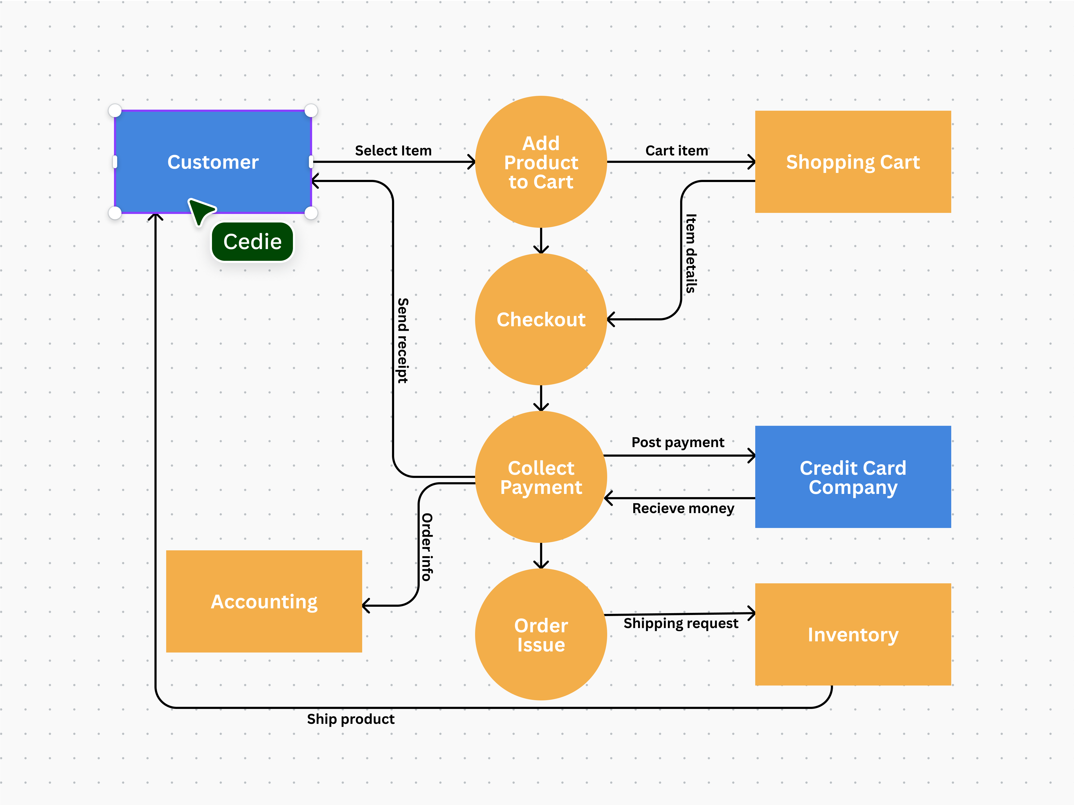

Slide 49
4. Requirement Modeling
Use Case Diagrams:
Depict the interactions between users (actors) and the system.
Help identify all possible ways the system will be used.
Provide a high-level overview of the functional requirements.

Slide 50
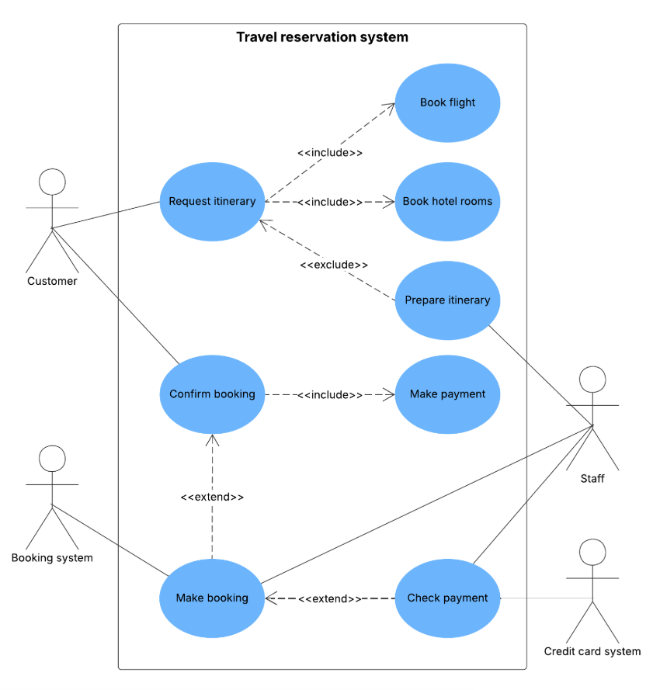

Slide 51
4. Requirement Modeling
Entity-Relationship Diagrams (ERD):
Represent data entities, their attributes, and relationships.
Useful for database design and understanding data requirements.

Slide 52
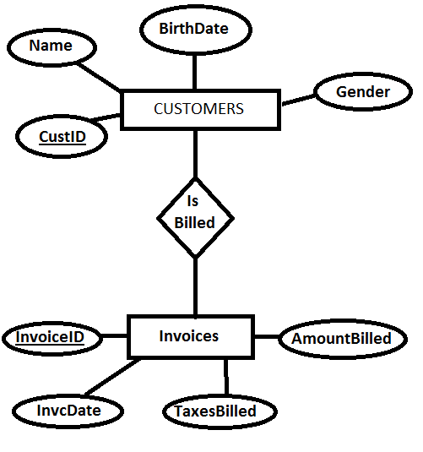

Slide 53
4. Requirement Modeling
State Diagrams:
Describe the states of an object and the transitions between these states.
Useful for systems with complex state-based behavior, such as user authentication.

Slide 54
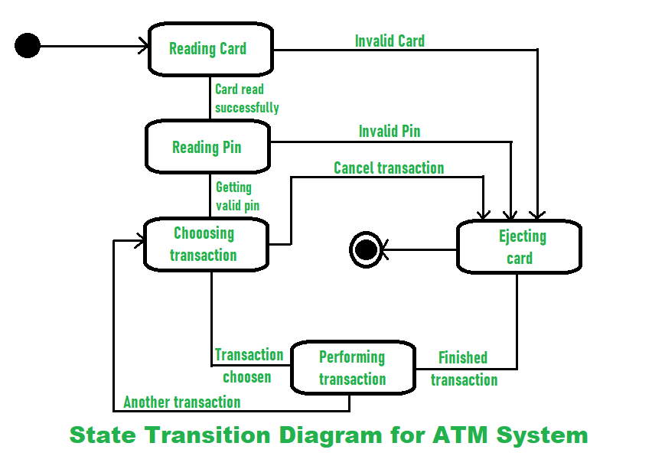

Slide 55
Quality Attributes of Good Requirements
Definition: Quality attributes ensure that requirements are clear, feasible, and verifiable. High-quality requirements are essential for the success of any project as they serve as the basis for design, development, and testing.
Key Attributes:
Clarity: Requirements should be free from ambiguity and easily understandable by all stakeholders.
Completeness: All necessary information should be included to avoid any gaps.

Slide 56
5. Quality Attributes of Good Requirements
Consistency: Requirements should not conflict with each other.
Feasibility: Requirements should be realistic and achievable within the project constraints.
Testability: Requirements should be stated in a manner that allows for verification and validation.

Slide 57
PIECES Framework for Requirement Analysis
Overview: The PIECES framework is a tool for analyzing existing systems and identifying potential areas for improvement. It evaluates six key areas: Performance, Information, Economy, Control, Efficiency, and Service.
Application:
Performance: Analyzing system response time, throughput, and workload capacity.
Information: Assessing the accuracy, availability, and timeliness of the information provided by the system.

Slide 58
PIECES Framework for Requirement Analysis
Economy: Evaluating the cost-effectiveness of the system and identifying potential cost-saving measures.
Control: Reviewing security, access control, and compliance with regulations.
Efficiency: Checking how well the system utilizes resources, including hardware, software, and personnel.
Service: Measuring user satisfaction and identifying areas for service improvement.

Slide 59
Tools for Requirement Analysis
Software Tools:
IBM DOORS: A comprehensive requirements management tool for capturing, tracking, and analyzing requirements.
Rational RequisitePro: Offers integrated requirements management with traceability and change control features.
JIRA: An agile project management tool with features for tracking requirements, issues, and changes.

Slide 60
Tools for Requirement Analysis
Modeling Tools:
Lucidchart: An online diagramming tool for creating DFDs, ERDs, and more.
Microsoft Visio: A versatile tool for creating professional diagrams and flowcharts.
UML Tools: For creating detailed UML diagrams that represent system interactions and structure.

Slide 61
Tools for Requirement Analysis
Traceability Tools:
ReQtest: Provides tools for managing requirements, test cases, and bugs.
Helix RM: Offers end-to-end requirements management with traceability and impact analysis.

Slide 62
References
“OWASP Product Security Guide | OWASP Foundation.” https://owasp.org/www-project-product-security-guide/
GeeksforGeeks, “Use Case Diagram Unified Modeling Language (UML),” GeeksforGeeks, Jun. 24, 2026. https://www.geeksforgeeks.org/system-design/use-case-diagram/
Atlassian, “User stories with examples and a template | Atlassian,” Mar. 10, 2026. https://www.atlassian.com/agile/project-management/user-stories
A. B. Salem, “Creating the perfect user story with INVEST criteria - Scrum-Master·Org,” Scrum Master #1, Jun. 20, 2024. https://scrum-master.org/en/creating-the-perfect-user-story-with-invest-criteria/

Slide 63
References
“Give / when / then acceptance criteria for user stories in agile development,” Visual Paradigm Guides, Sep. 18, 2023. https://guides.visual-paradigm.com/give-when-then-acceptance-criteria-for-user-stories-in-agile-development/
ProductPlan, “Kano Model | Glossary | ProductPlan,” ProductPlan, Apr. 21, 2026. https://www.productplan.com/glossary/kano-model
C. Team, “What is a Data Flow Diagram (DFD)? Examples & Tips | Canva,” Canva, Jun. 09, 2026. https://www.canva.com/online-whiteboard/data-flow-diagrams/

